Slide 1

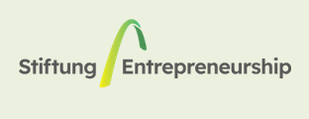



WMF2025 Startup Competition
International startup challenge for digital innovation
Presentation of an international program
By Prof. Hichem NASRI & Prof. Safieddine OUNIS
Pays d’origine
Public cible
Site web
https://en.wemakefuture.it/call/startup-competition/

Slide 3
ELIGIBILITY
Who can apply?
Innovative startups worldwide, including every stage of the start-up, from early-stage to growth-stage.

Slide 4
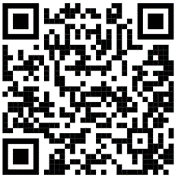
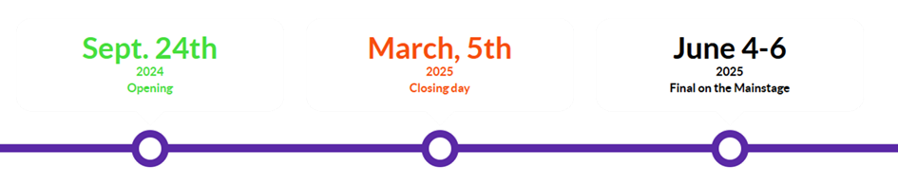
APPLICATION TIMELINE & PROCESS
Application period
- September 24th , 2024 – March 5th , 2025
Submission platform
https://en.wemakefuture.it/call/startup-competition/
Timeline

Slide 5
Required information:
Team details: Information about the proposer, including name, contact details, role, and team composition, development stage of the company/product.
Company profile: Company name, location (country), year of establishment, development stage (again)
Project description: Project name, brief description, alignment with one or more of the 12 Future Challenges identified by WMF, and impact on the 17 UN Sustainable Development Goals (SDGs), and if it meets with the ESG Criteria (Environmental, Social, Governance)
Documentation: Attachments such as project pitch (pdf, ppt, pptx, doc, docx; max 10MB) and additional supporting documents like executive summaries or business plans

Slide 6
SELECTION PROCESS
Evaluation criteria:
Team strength: Founders’ expertise, industry background.
Innovation: Differentiation, feasibility.
Market readiness: Demand, scalability.
Business model: Revenue potential, funding strategy.
Impact factor: ESG, SDG contributions
Phases:
1. Initial screening: Review of applications
2. Semi-finals: Pitch evaluation
3. Finals: Top 6 startups pitch on WMF Mainstage

Slide 7
BENEFITS FOR PARTICIPANTS
1. Training and exposure: our students will be able to understand international startup ecosystems and standards
2. Pitch on Mainstage and get feedback from a jury of VCs, corporate executives and startup experts, making them top candidates for local grants, research funding and partnerships.
3. Access to over €2 million in prizes, funding, and in-kind services
4. Startup showcase at the WMF Startup District
5. High-level networking with investors and partners

Slide 8

CONTACT AND RESOURCES | Q&A
Inquiries: info@wemakefuture.it | +39 051 0951294
More details: Visit the WMF website

